Slide 1
AI& Python Program
Crawler Project
No.8 陳柏翰
gilbert8341699@gmail.com

Slide 2

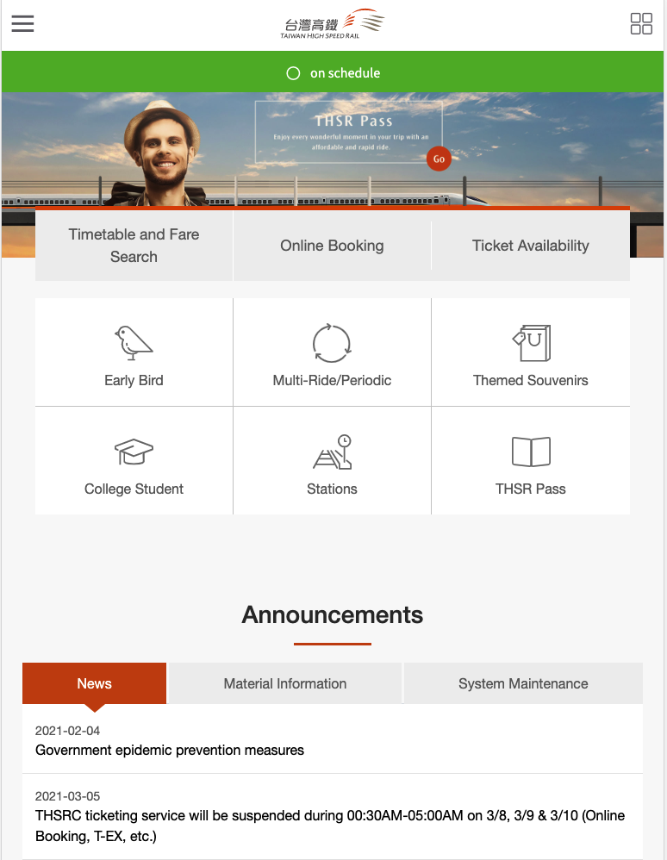


.
INTRODUCTION& OUTLINE
Our life is closely linked to…
Line
Linkedin
Difficulty& Solution
Prospect& Enhacement

Slide 3


Line Sticker Auto-download

Slide 4
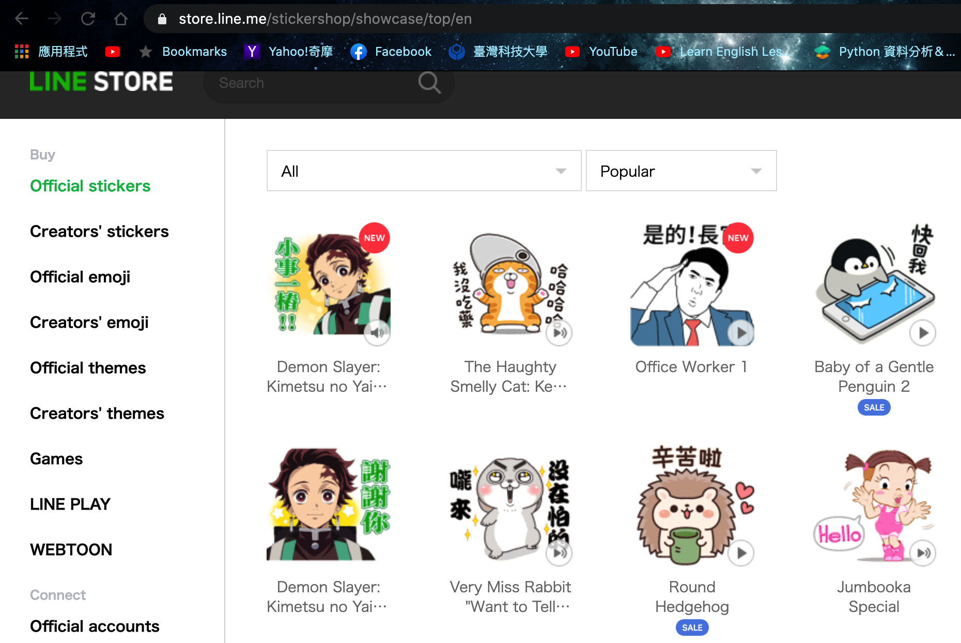
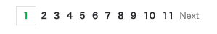
Target:
1
Popular Stickers Auto-download
Popular Stickers Auto-download
Real URL:
2
https://store.line.me/stickershop/showcase/top/en?page=1 Same as Original Source
Find all links of sticks
3
BeautifulSoup: a[“href”]
Find all images in sticks
4
def download_all(url):
Download to png.
5
Def download_line(url):

Slide 5

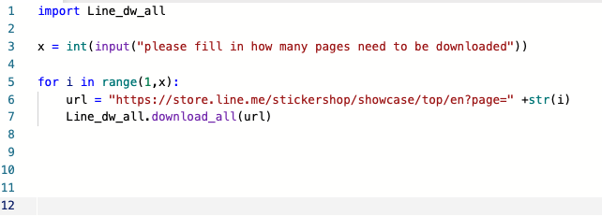
.
Use loop to get every page of stickers
Execute download_all
Parameters: url + page

Slide 6

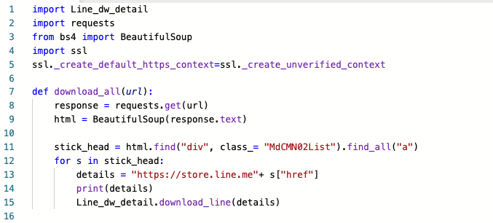
.
Find every sticks detail page
def download_all(url):

Slide 7
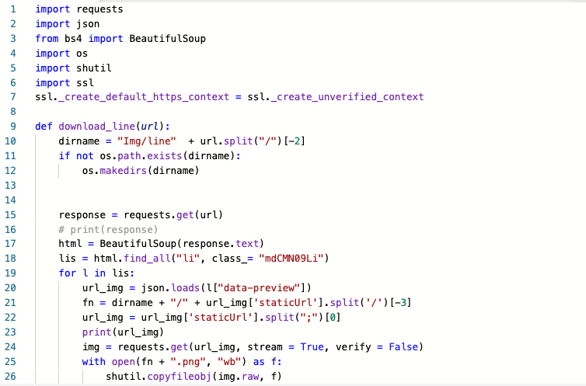
.
Download every images in each sticks
def download_line(url):
To download every images in 鬼滅之刃

Slide 8
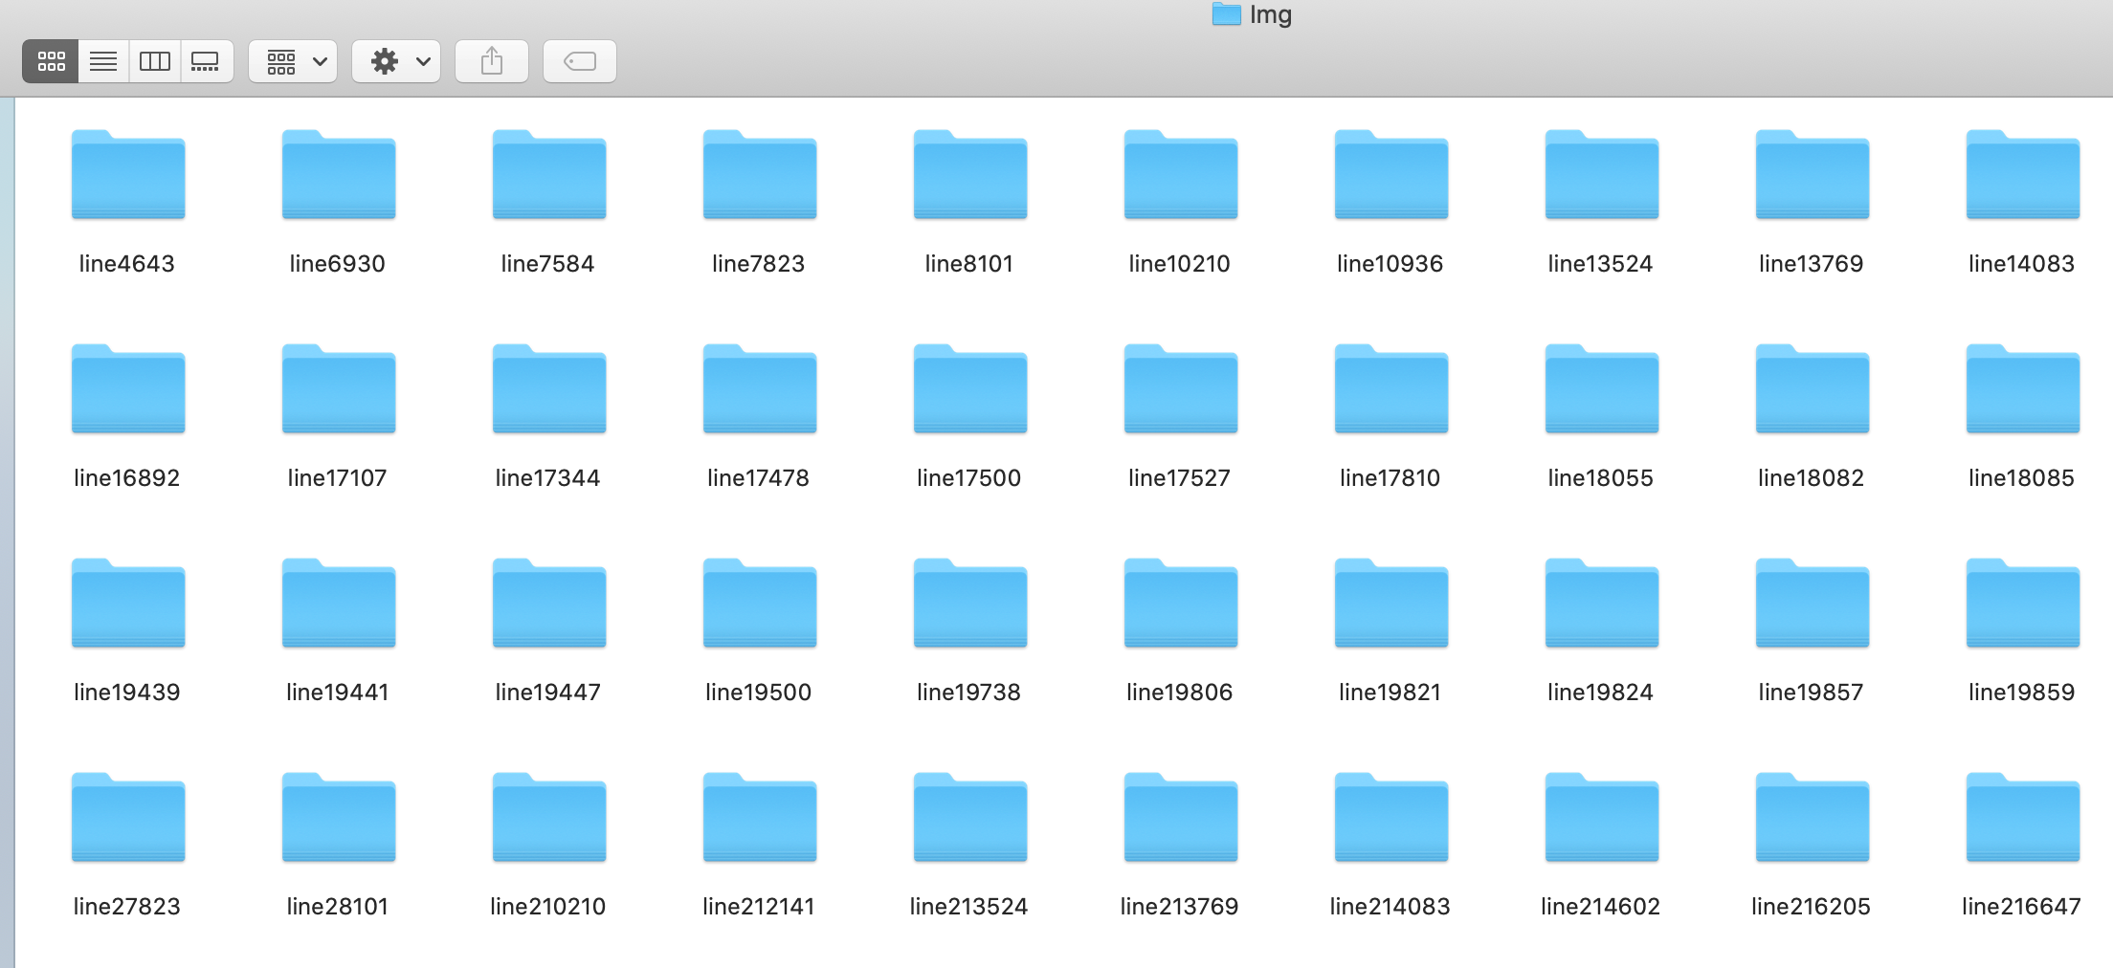
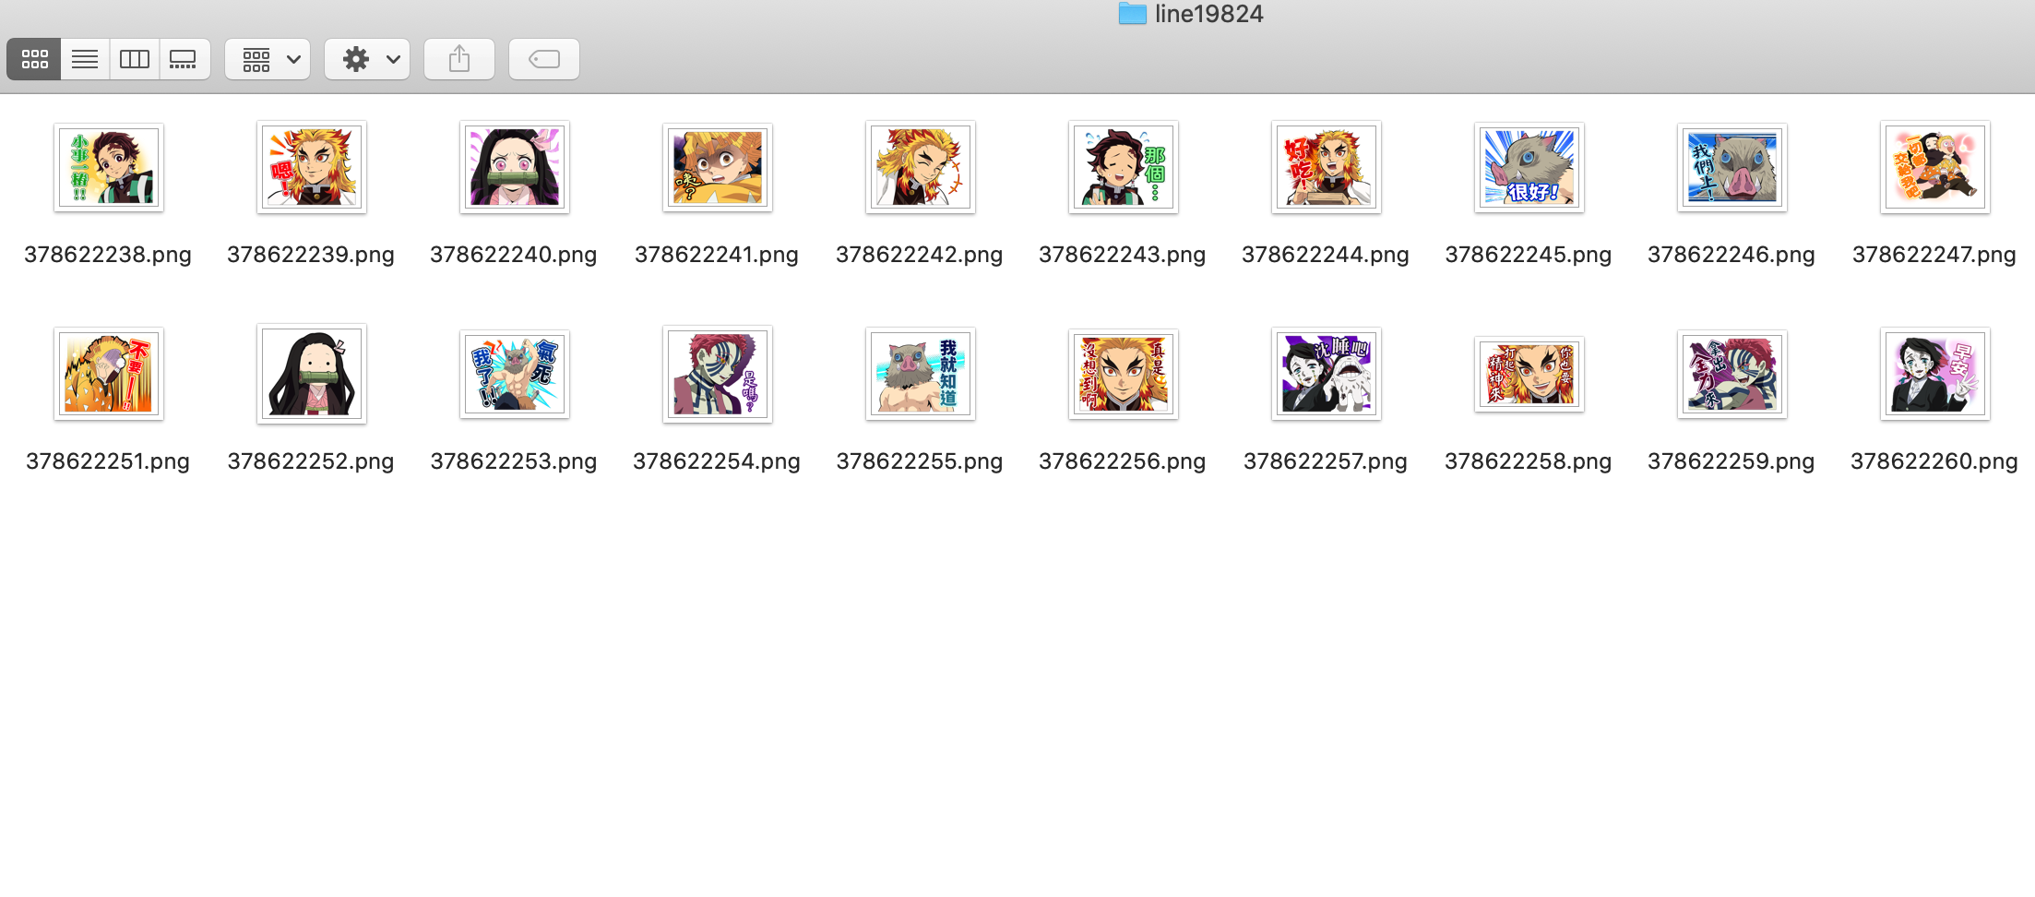
.
Result of stickers auto-download
https://github.com/gilbert83416/NTUT-Crawler-Project/blob/main/Project_line.ipynb

Slide 9
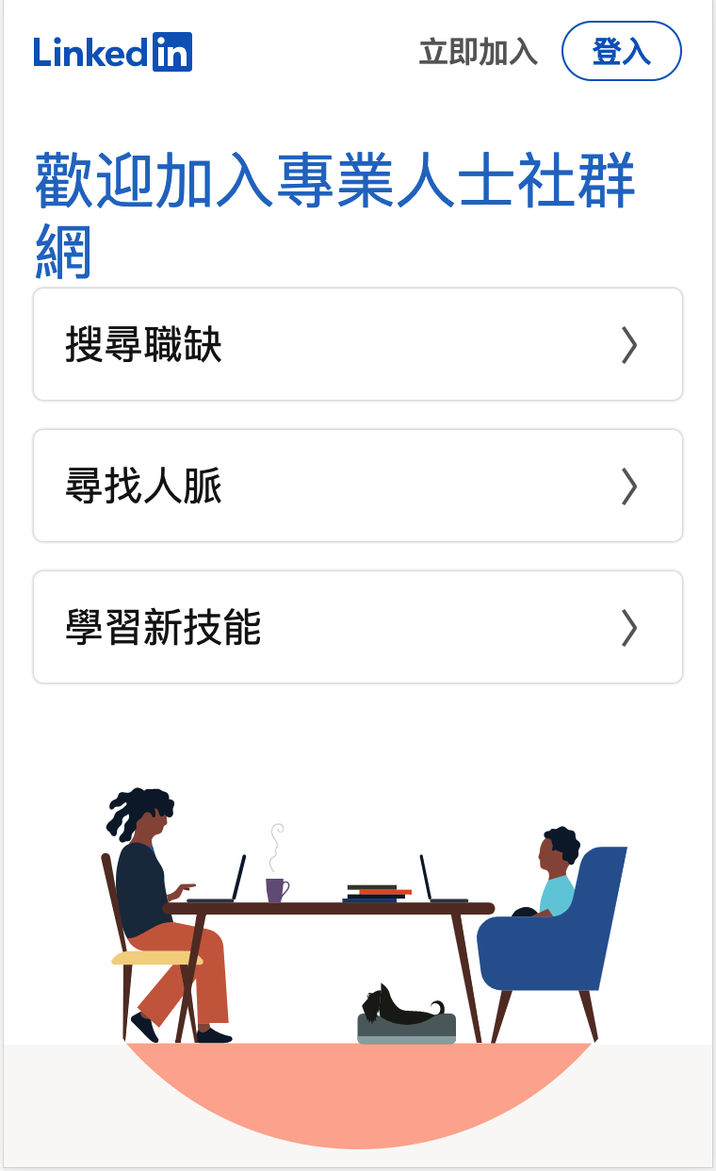

Linkedin Job list Auto-download

Slide 10

Target:
1
Job list Auto-download to .csv and google worksheet
Position : Data Analyst Auto-download
Real URL:
2
https://www.linkedin.com/jobs-guest/jobs/api/seeMoreJobPostings/search?geoId=104187078&keywords=data%20analyst&start=
+ str(i)+
"&redirect=false&position=1&pageNum=0”
3
To get the IDs of all Jobs
Use IDs to crawl the Job info.
4
(Position/Company/Description/Location…)
Download to .csv and google worksheet
5
Plus: send the link of sheet via Line Notify

Slide 11
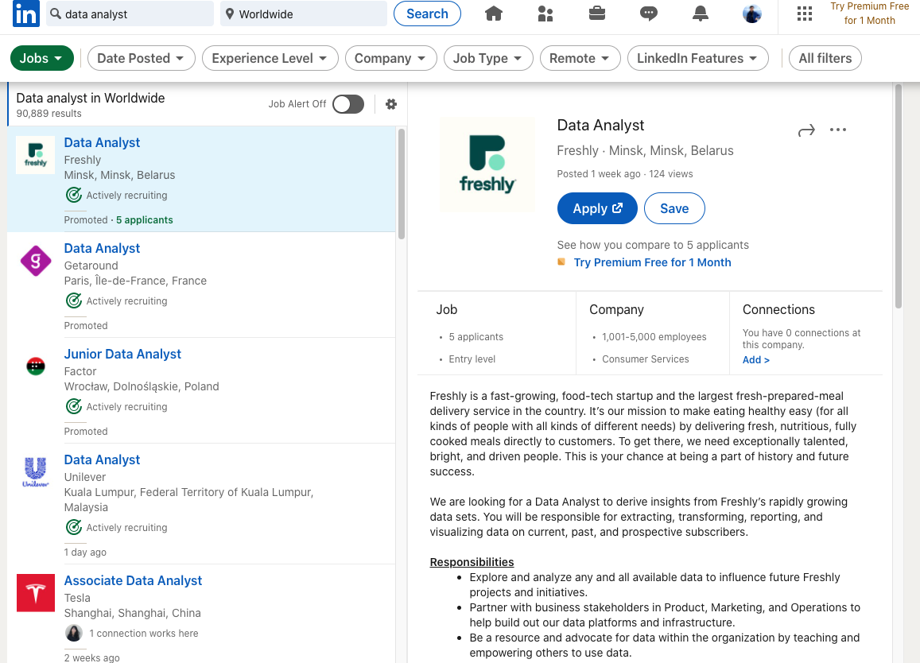
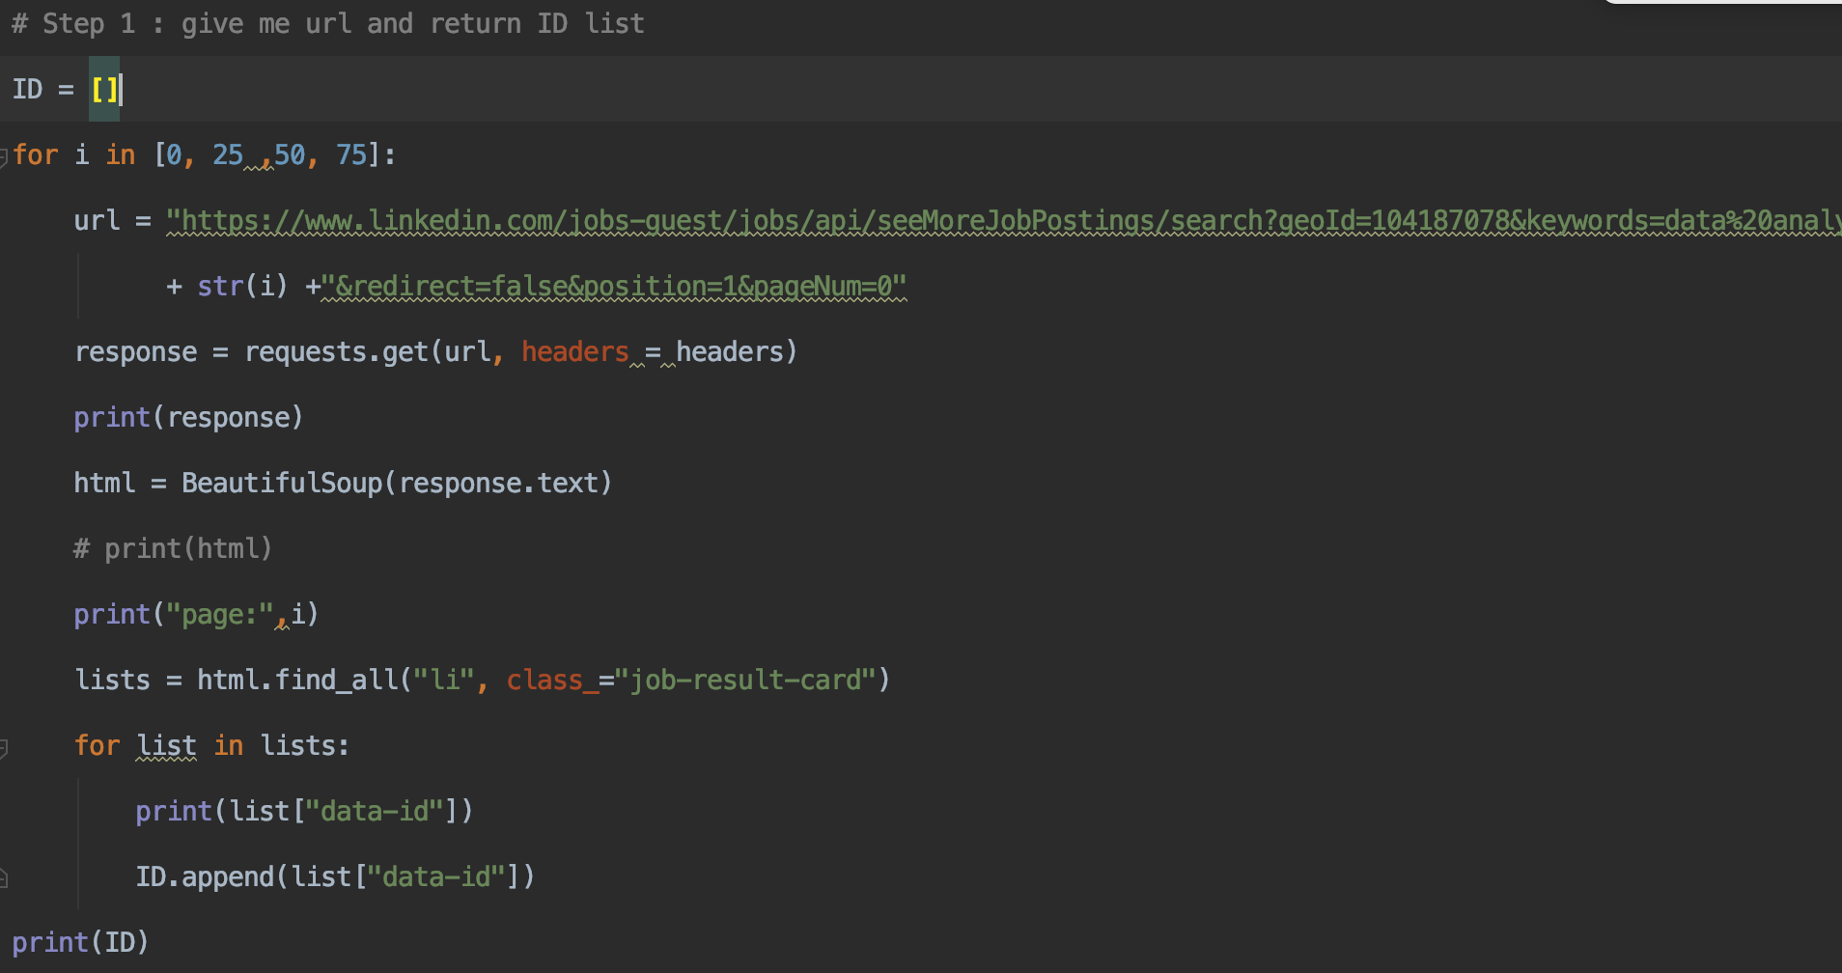
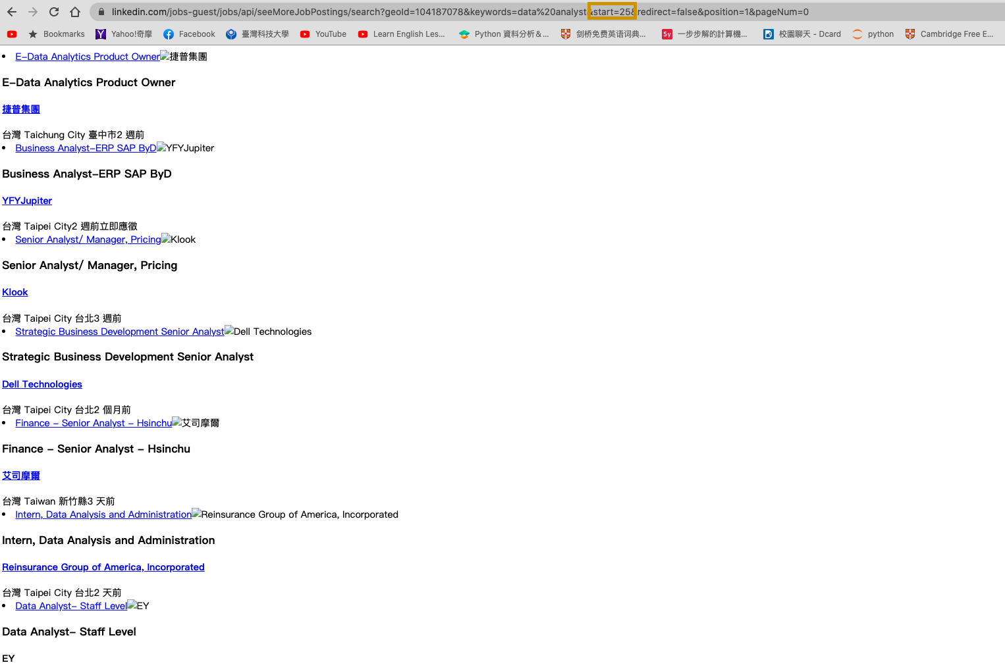
.
Use page number to determine how much jobs would like to download
https://www.linkedin.com/jobs-guest/jobs/api/seeMoreJobPostings/search?geoId=104187078&keywords=data%20analyst&start=
+ page: 0, 25, 50, 75 +
"&redirect=false&position=1&pageNum=0”

Slide 12
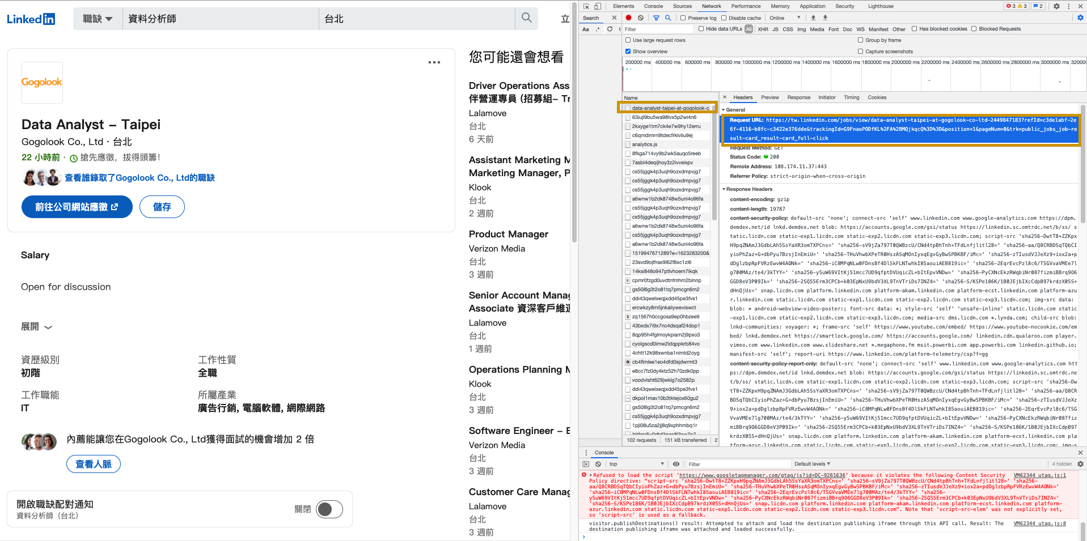
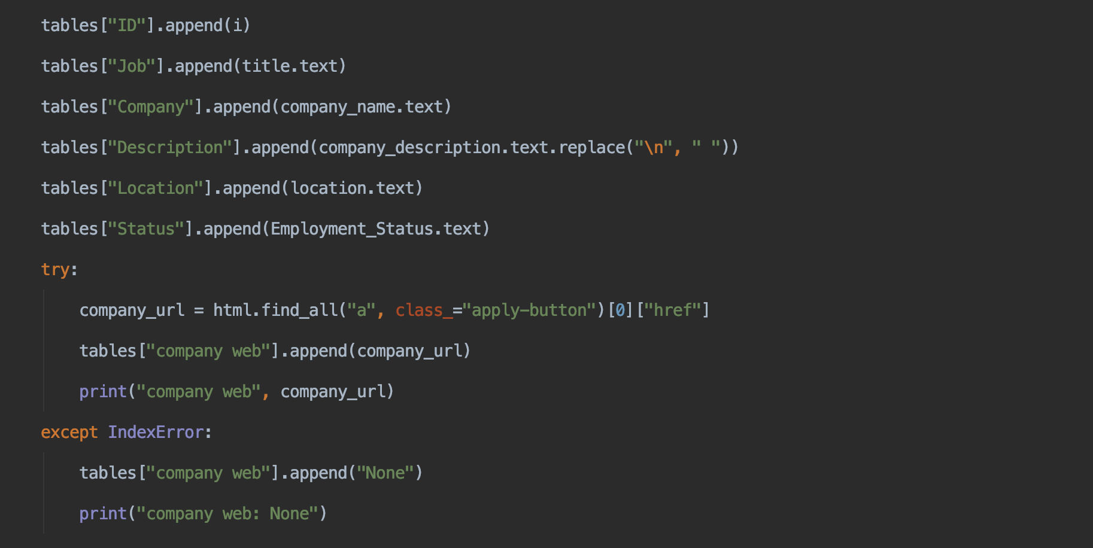
.
Find the necessary info. of the Jobs: Position/Company/Description/Location…
IndexError for N/A data

Slide 13
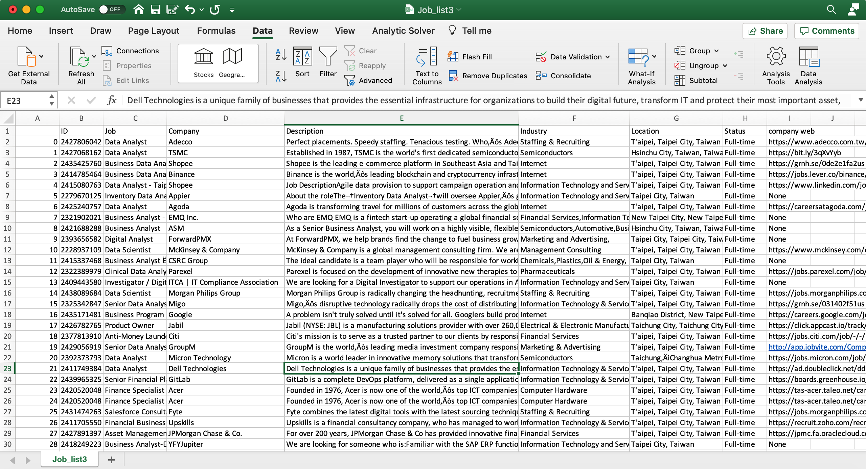
.
Save the data to .csv file
Difficulty:
(1) 403 Forbidden/CSRF Failed: Add Header+ CSRF token
(2) Version Update Frequency
(2-1) Different data Format(JSON/HTML) or missing data:
Use Try & Except

Slide 14
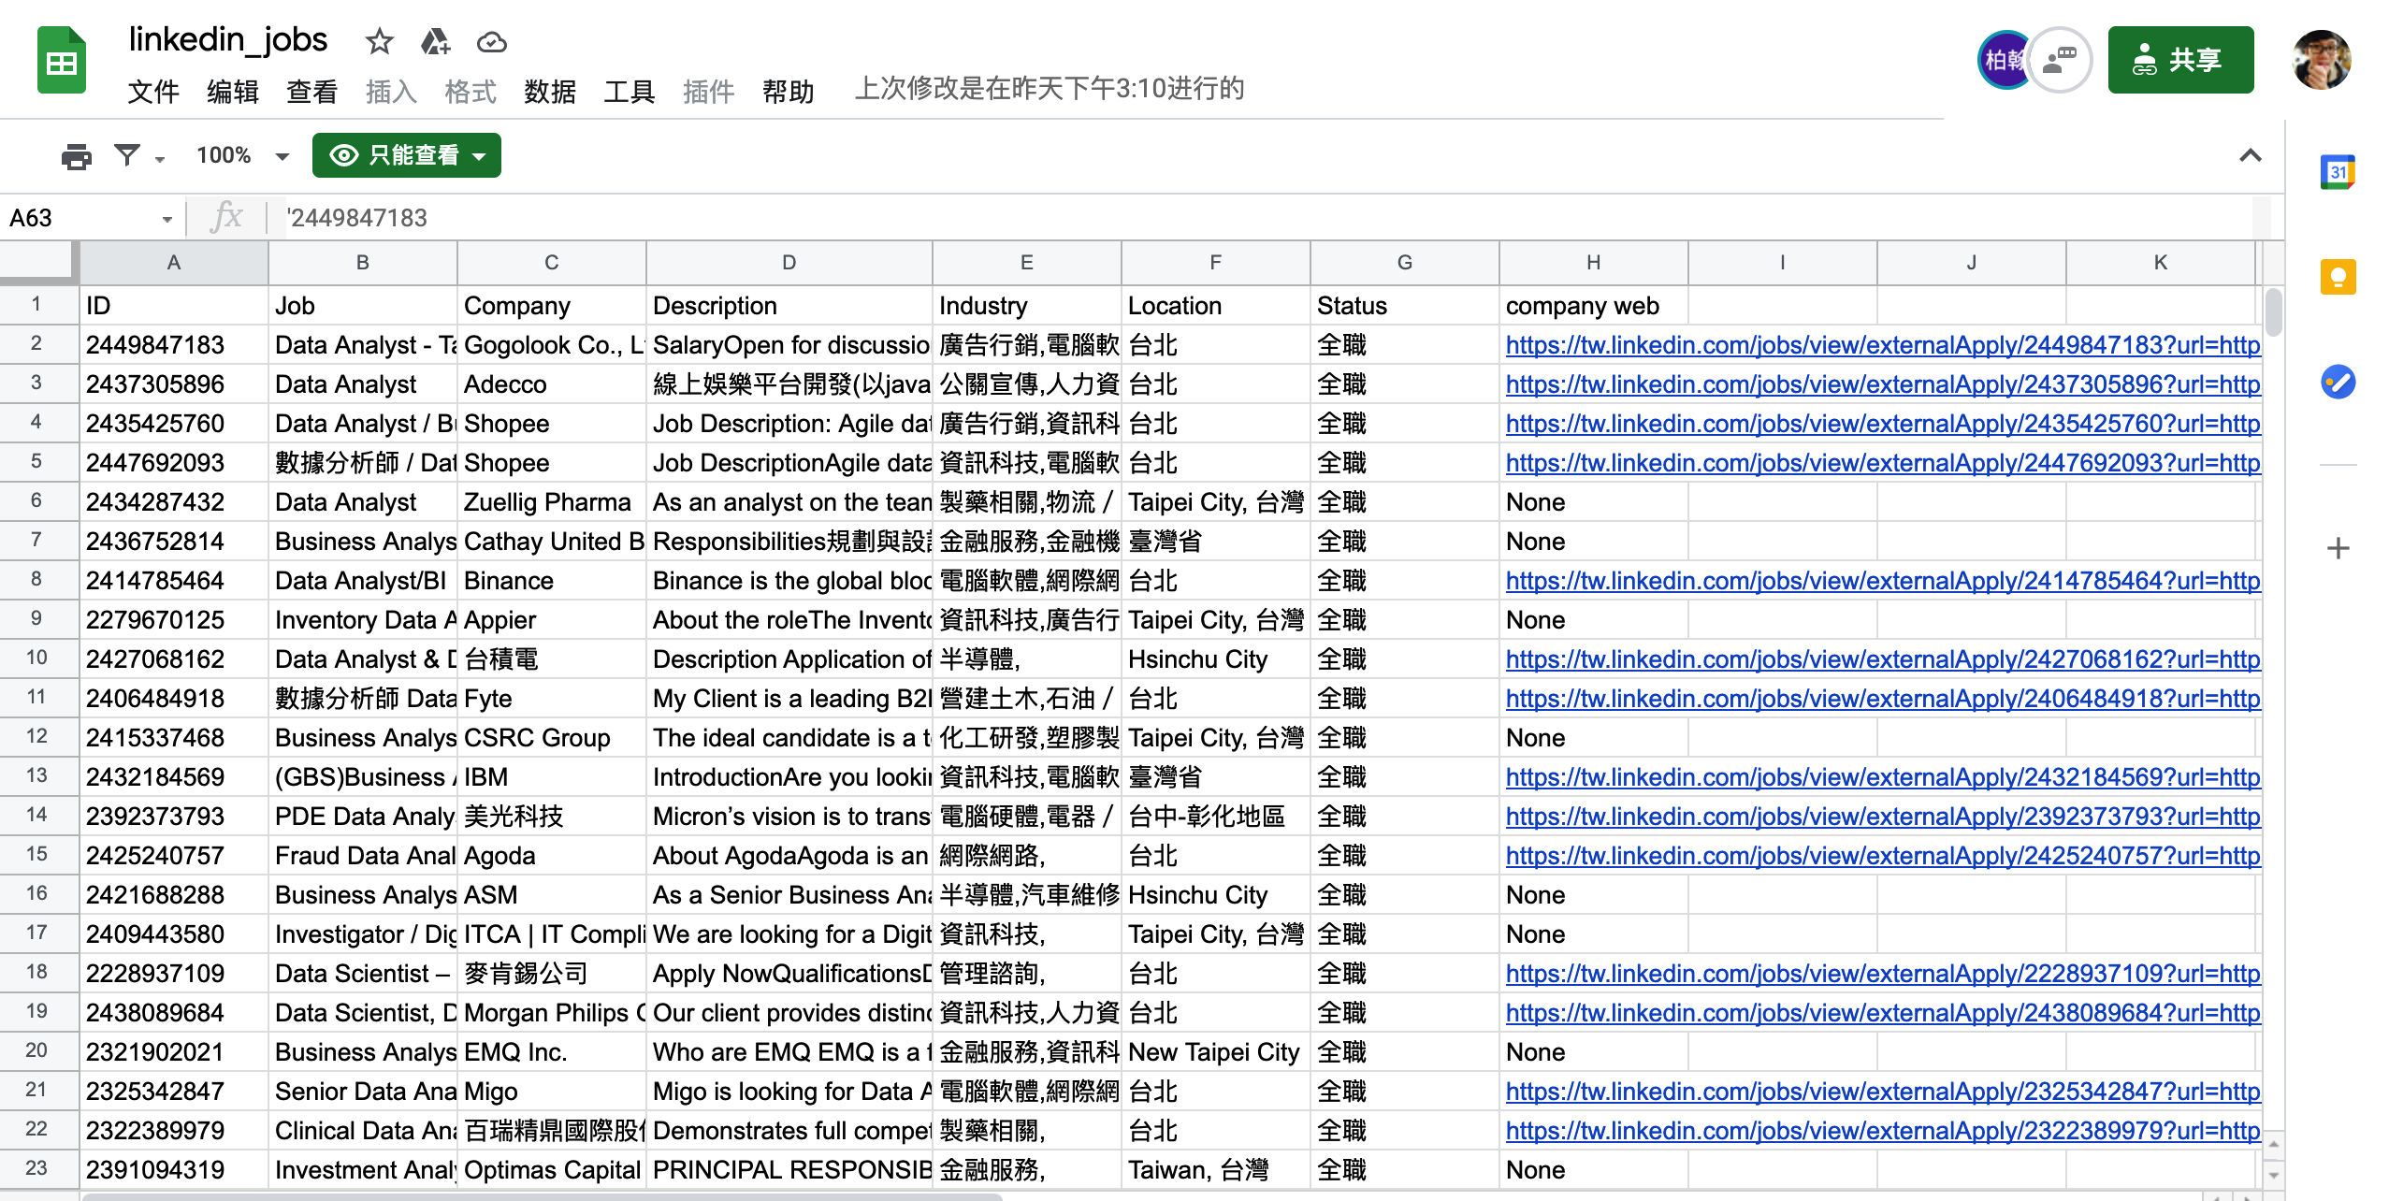
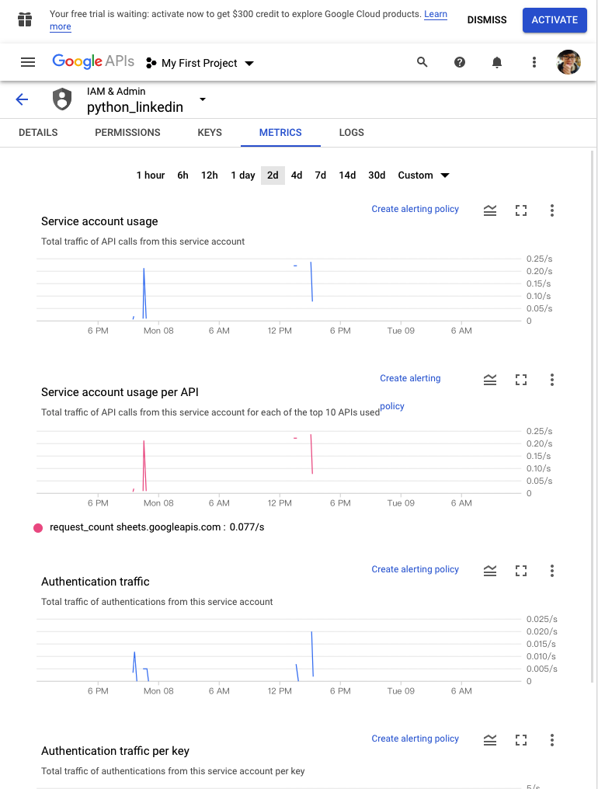
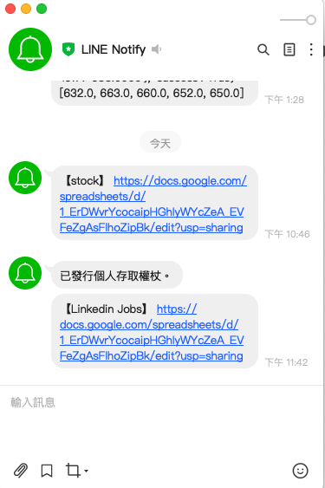
Plus: auto-export data to google worksheet
Auto-send the Notification via Line
(1)Google Developers Console : https://console.developers.google.com/
(2)Line Notify: https://notify-bot.line.me/doc/en/

Slide 15
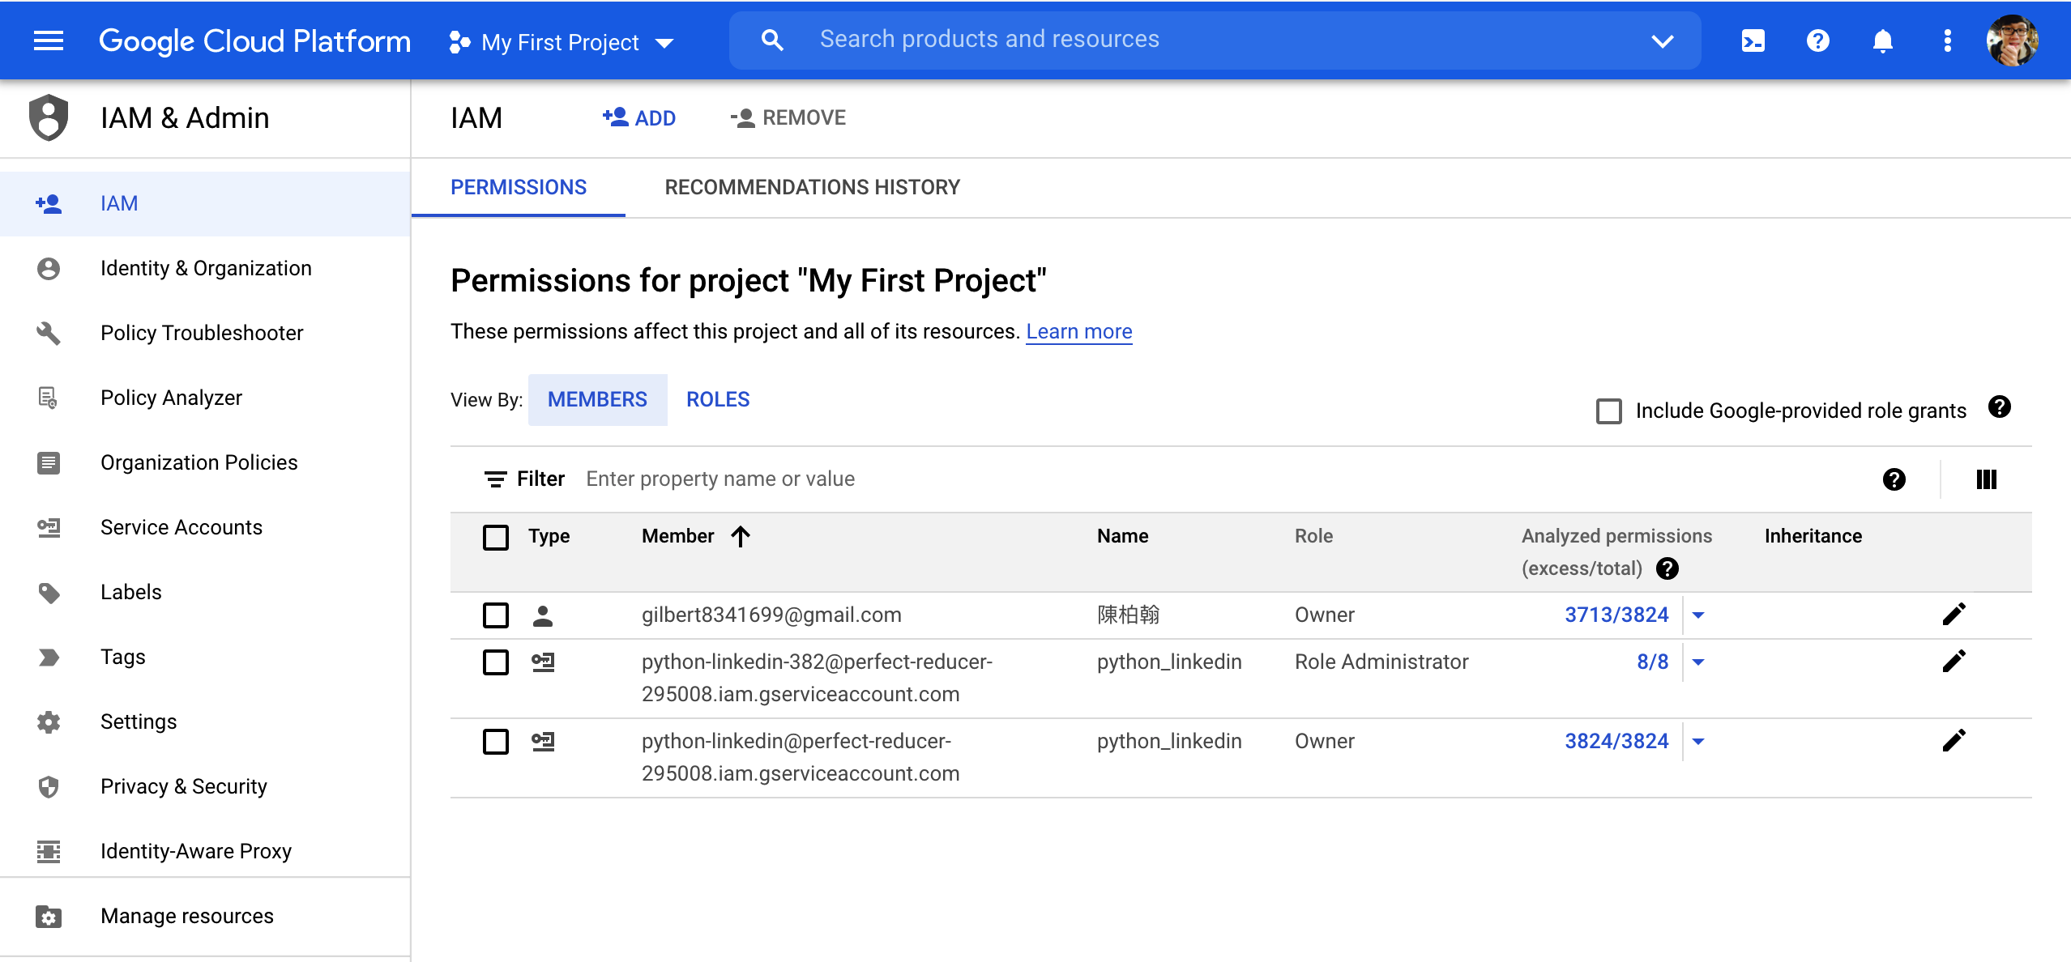
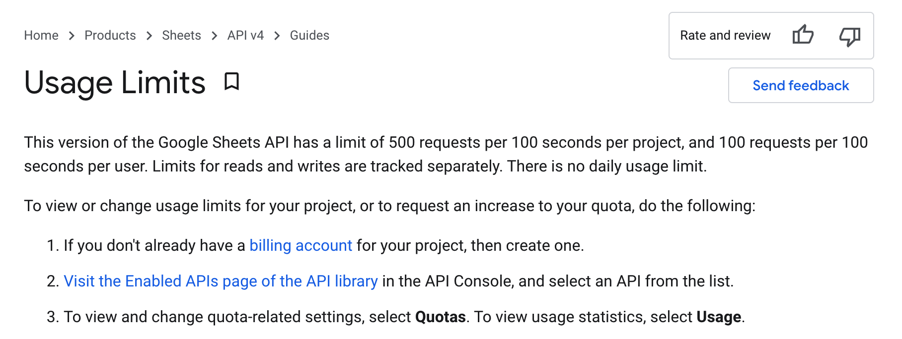
.
Save the data to google worksheet
Difficulty(API Limitation- sleep)

Slide 16
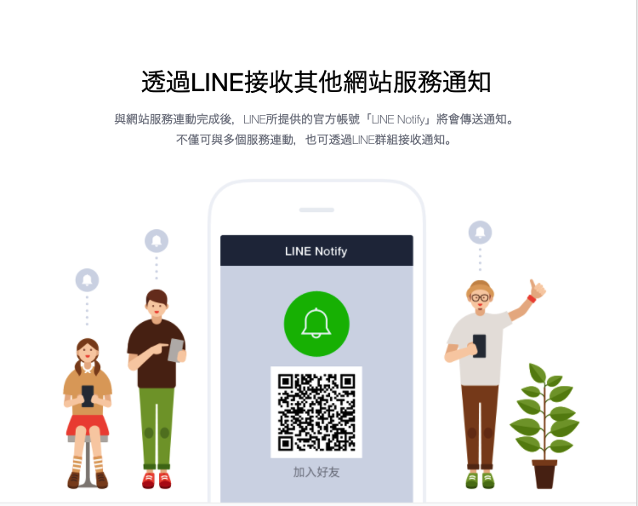
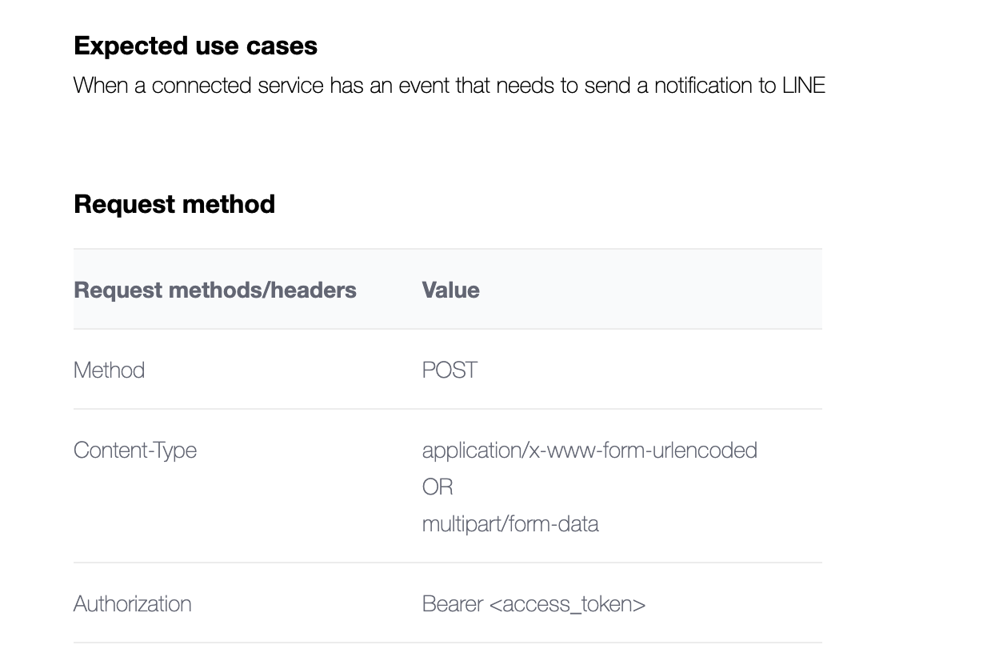
.
Send the link of google sheet via Line Notify
Difficulty(API setting method)
https://github.com/gilbert83416/NTUT-Crawler-Project/blob/main/Project_linkedin.ipynb

Slide 17
Prospect& Enhancement
Download the data by schedule
Schedule
Find the key word and skills in the position by word cloud
User can input the position what ever
They want to search
Key word
Any position

Slide 18
Thank you
Q&A

